Slide 1

Computer Graphics
Deepankar Sharma

Slide 2
Introduction to Computer Graphics: • Definition, • Applications, • Graphics Hardware, • Display Devices: § Refresh Cathode Ray Tube, § Raster Scan Display, § Plasma display, § Liquid Crystal display, § Plotters, § Printers.

Slide 3




































Definition

Slide 4














Definition
It is the use of computers to create and manipulate pictures on a display device. It comprises of software techniques to create, store, modify, represents pictures.

Slide 5
Applications
User Interfaces
Plotting Graphs and Charts
Office Automation and Desktop Publishing
Computer Aided Designing and Drafting
Simulation and Animation
Art and Commerce
Process Control
Cartography

Slide 6























Important Terms
Pixel
Resolution
PPI
Aspect Ratio
Frame Buffer

Slide 7


























Scan Conversion and Rasterization

Slide 8









































Graphics Hardware

Slide 9






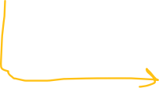











































Cathode Ray Tube(CRT)

Slide 10




















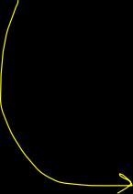








Rastor Scan Display

Slide 11
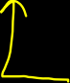













































Vector Scan Display

Slide 12
















































































Slide 13




















































Interlacing

Slide 14












































































Beam Penetration
Shadow Masking

Slide 15







































Flat Panel Display

Slide 16



































































Plasma Display

Slide 17








































LED

Slide 18






































































LCD

Slide 19














































































LED vs LCD

Slide 20
Mathematics of Computer Graphics: • Point representation, • Vector representation, • Matrices and operations related to matrices, • Vector addition and vector multiplication, • Scalar product of two vectors, • Vector product of two vectors. Parametric equations of lines and conics.

Slide 21










Vectors

Slide 22
Vectors

Slide 23
Line Drawing Algorithms: • DDA algorithms, • Bresenham’s Line algorithm. • Circle and ellipse generation algorithm. Clipping: • Point Clipping, • Line Clipping. • Polygon Clipping. Filling: • Inside Tests, • Flood fill algorithm, • Boundary-Fill Algorithm and • scan-line polygon fill algorithm.

Slide 24

















DDA Line Drawing Algorithm

Slide 25







DDA Line Drawing Algorithm

Slide 26

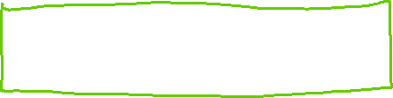



DDA

Slide 27












Bresenham’s Line Drawing Algorithm

Slide 28
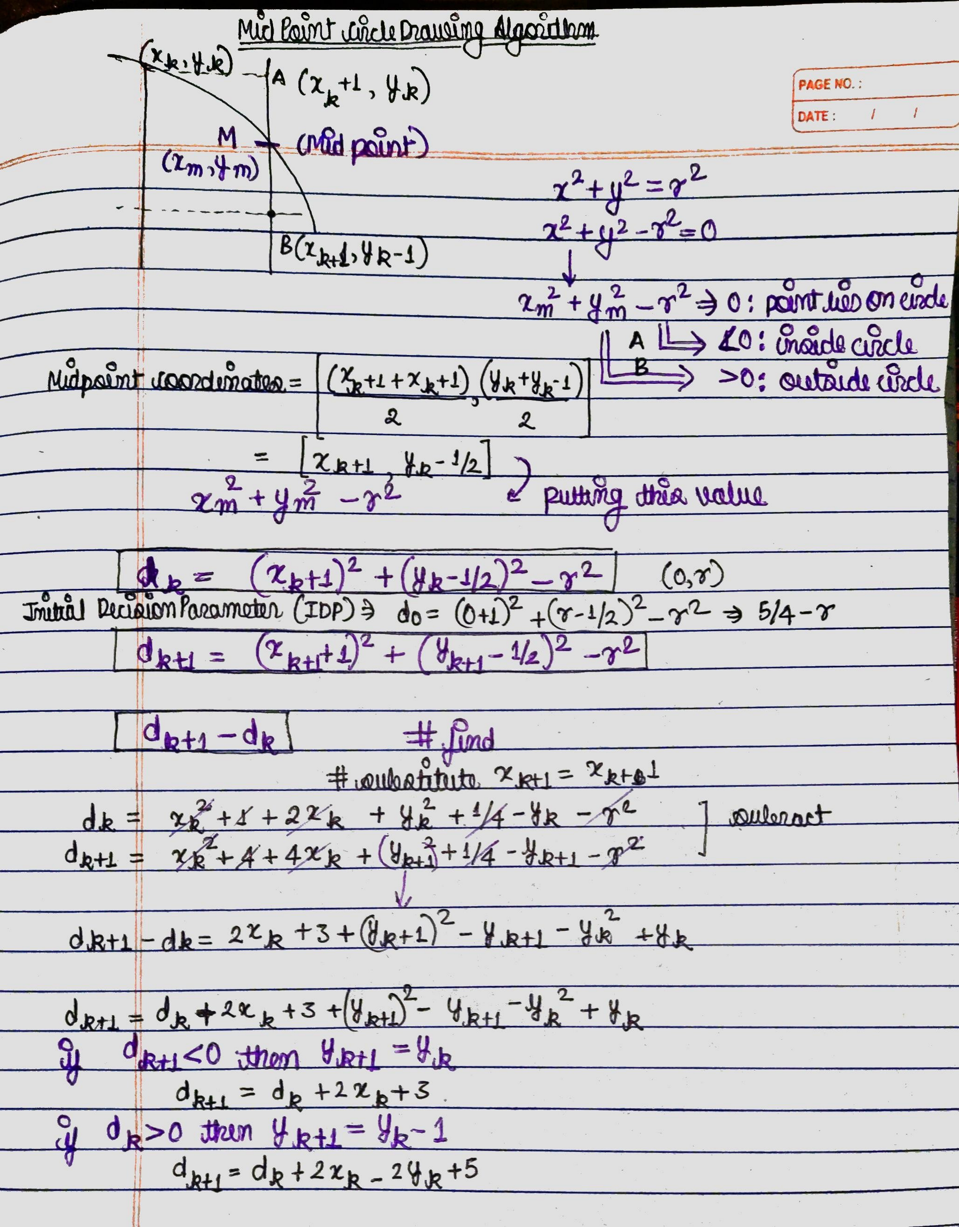











Mid Point Circle

Slide 29



Brensenham Circle

Slide 30












































Mid Sem-Practical

Slide 31
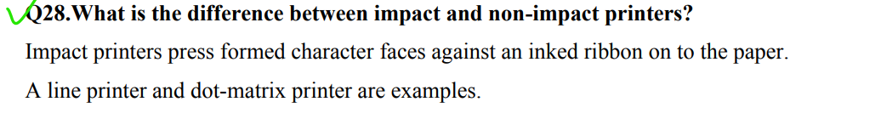
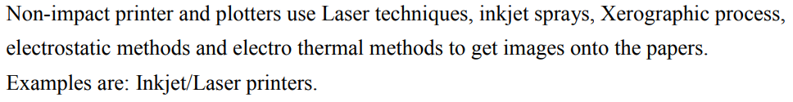


















Viva Prep

Slide 32
Viva Prep

Slide 33










void DDA(int x1, int y1, int x2, int y2){ int dx= x2-x1; int dy= y2-y1; int steps= dx>=dy? abs(dx):abs(dy); float xinc= dx/(float)steps; float yinc= dy/(float)steps; int i= 0; cout<<xinc<<'\t'<<yinc<<endl; cout<<"\nThe consequent coordinates are: "<<endl; int x= x1, y=y1; cout<< "x0: "<<x<<", y0:"<<y<<endl; while (i<=steps) // while (i<=10) { /* code */ putpixel(x, y, RED); x+=xinc; y+=yinc; i++; cout<< "x_next: "<<x<<", y_next:"<<y<<endl; } putpixel(x, y, RED); }

Slide 34







void brensanham(int x0, int y0, int x1, int y1){ int x=x0; int y=y0; if (x0 > x1) { x = x1; y = y1; x1 = x0; y1 = y0; x0 = x; y0 = y; } int dx= x1-x0; int dy= y1-y0; int p= 2*dy-dx; while(x<x1){ if(p>=0){ putpixel(x,y,WHITE); y=y+1; p=p+2*dy-2*dx; } else{ putpixel(x,y,WHITE); p=p+2*dy; } x=x+1; } }

Slide 35











void drawMidPointCircle(int x0, int y0, int radius){ int y = radius, x = 0; int decisionParam = 1 - radius; while (x <= y) { putpixel(x0 + x, y0 + y, 1); putpixel(x0 - x, y0 + y, 2); putpixel(x0 + x, y0 - y, 3); putpixel(x0 - x, y0 - y, 4); putpixel(x0 + y, y0 + x, 5); putpixel(x0 - y, y0 + x, 6); putpixel(x0 + y, y0 - x, 7); putpixel(x0 - y, y0 - x, 8); delay(400); x++; if (decisionParam <= 0) decisionParam += 2 *x + 1; else{ y--; decisionParam += 2 * (x-y) + 1; } } }

Slide 36






void drawBrensanhamCircle(int x0, int y0, int radius){ int x = 0, y = radius; int decisionParam = 3 - 2 * radius; while (x <= y) { putpixel(x0 + x, y0 + y, RED); putpixel(x0 + y, y0 + x, RED); putpixel(x0 - y, y0 + x, RED); putpixel(x0 - x, y0 + y, RED); putpixel(x0 - x, y0 - y, RED); putpixel(x0 - y, y0 - x, RED); putpixel(x0 + y, y0 - x, RED); putpixel(x0 + x, y0 - y, RED); if (decisionParam <= 0){ x++; decisionParam += 4 * x + 6; } else{ x++; y--; decisionParam += 4 * (x - y) + 10; } } }

Slide 37
Traffic Light
void drawTrafficLight(int x, int y, int lightSize, bool isRedOn, bool isYellowOn, bool isGreenOn){
// Draw black background
setfillstyle(SOLID_FILL, BLACK);
bar(x, y, x + lightSize, y + 3 * lightSize);
// Draw red light
setfillstyle(SOLID_FILL, isRedOn ? RED : DARKGRAY);
circle(x + lightSize / 2, y + lightSize / 2, lightSize / 2);
floodfill(x + lightSize / 2, y + lightSize / 2, WHITE);
// Draw yellow light
setfillstyle(SOLID_FILL, isYellowOn ? YELLOW : DARKGRAY);
circle(x + lightSize / 2, y + lightSize + lightSize / 2, lightSize / 2);
floodfill(x + lightSize / 2, y + lightSize + lightSize / 2, WHITE);
// Draw green light
setfillstyle(SOLID_FILL, isGreenOn ? GREEN : DARKGRAY);
circle(x + lightSize / 2, y + 2 * lightSize + lightSize / 2, lightSize / 2);
floodfill(x + lightSize / 2, y + 2 * lightSize + lightSize / 2, WHITE);
}

Slide 38





Traffic Light
void red_circle()
{
setfillstyle(SOLID_FILL, RED);
circle(35, 35, 25);
floodfill(35, 35, WHITE);
}
void yellow_circle()
{
setfillstyle(SOLID_FILL, YELLOW);
circle(35, 85, 25);
floodfill(35, 85, WHITE);
}
void green_circle()
{
setfillstyle(SOLID_FILL, GREEN);
circle(35, 135, 25);
floodfill(35, 135, WHITE);
}
while (1)
{
rectangle(10, 10, 60, 160);
red_circle();
delay(400);
cleardevice();
rectangle(10, 10, 60, 160);
yellow_circle();
delay(400);
cleardevice();
rectangle(10, 10, 60, 160);
green_circle();
delay(400);
cleardevice();
}

Slide 39
Smiley
#include <graphics.h>
int main(){
// draw graphics using graphics.h
int gDriver = DETECT, gMode;
initgraph(&gDriver, &gMode, NULL);
// draw a circle
circle(200, 200, 100);
// draw a smile
arc(200, 200, 210, 330, 50);
// draw eyes
circle(170, 180, 5);
circle(230, 180, 5);
// draw a nose
line(200, 200, 200, 230);
getch();
closegraph();
return 0;
}

Slide 40
Hut
#include<graphics.h> int main(){
// draw a hut
int gDriver = DETECT, gMode;
initgraph(&gDriver, &gMode, NULL);
// draw a rectangle
rectangle(100, 100, 300, 300);
// draw a triangle
line(100, 100, 200, 50);
line(200, 50, 300, 100);
line(100, 100, 300, 100);
// draw a door
rectangle(150, 230, 200, 300);
circle(150, 150, 30);
circle(250, 150, 30);
getch();
closegraph();
return 0;
}

Slide 41




Important Functions of <graphics.h>
// Initializes the graphics system
void initgraph(int *graphdriver, int *graphmode, const char *path);
// Closes the graphics system
void closegraph();
// Waits for a key press event and returns the key code
int getch();
// Draws a pixel of specified color at the given (x, y) coordinate
void putpixel(int x, int y, int color);
// Draws a line between two given points
void line(int x1, int y1, int x2, int y2);
// Draws a rectangle with given top-left and bottom-right coordinates
void rectangle(int left, int top, int right, int bottom);

Slide 42

Important Functions of <graphics.h>
// Draws a circle with given center and radius
void circle(int x, int y, int radius);
// Draws an ellipse with given center, horizontal and vertical radius
void ellipse(int x, int y, int start_angle, int end_angle, int xradius, int yradius);
// Draws an arc with given center, radius, and start and end angles
void arc(int x, int y, int start_angle, int end_angle, int radius);
// Sets the current drawing color to the specified color
void setcolor(int color);
// Sets the fill pattern and color for the next fill operation
void setfillstyle(int pattern, int color);
// Writes the specified text string at the given (x, y) position on the screen
void outtextxy(int x, int y, const char *text);

Slide 43
Important Functions of <graphics.h> // Sets the font and size of the text to be drawn void settextstyle(int font, int direction, int charsize); // Returns the maximum x coordinate of the current graphics screen int getmaxx(); // Returns the maximum y coordinate of the current graphics screen int getmaxy(); void floodfill(int x, int y, int boundary_color);

